Slide 1
Neutralisation Reactions

Slide 2
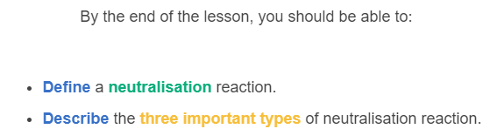
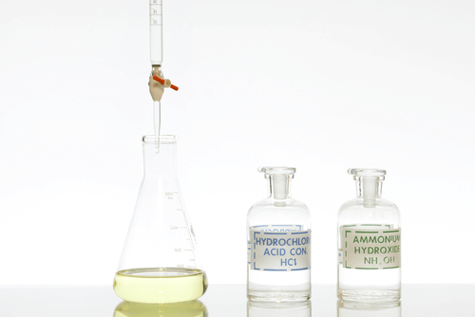

Slide 3
There are many different types of acids and bases.
However, in this lesson we will be focusing on three specific types of bases, because these are the most common.
These are hydroxides, oxides and carbonates.

Slide 4
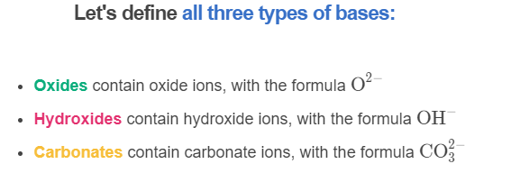

Slide 5
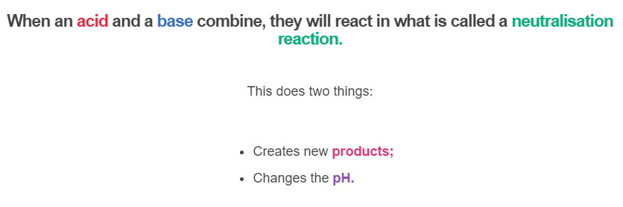

Slide 6
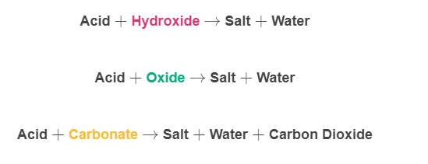

The product of a neutralisation (acid-base) reaction will change depending on the base.
Here are the different reactions which happen with each base:

Slide 7
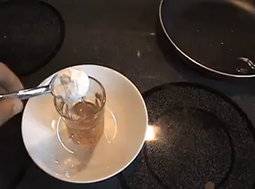
All three reactions produce salts and water, but only carbonate produces carbon dioxide.
This means that these reactions can be told apart from the other two reactions because of the carbon dioxide bubbles.

Slide 8

The other use of neutralisation reactions is to fine-tune a specific pH.
For example, animals and plants often need specific pHs of water and soil to live.
Combining an acid and a base will not always create a neutral solution. Rather, the final pH depends on the pHs of the acids and bases that have been reacted.

Slide 9
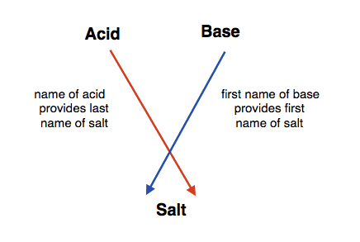
As with acid-metal reactions, neutralisation reactions also produce salts that can be named as per the information below:
When a hydrochloric acid is used, a chloride will form.
When nitric acid is used, a nitrate will form.
When sulfuric acid is used, a sulfate will form.

